Slide 1



TECHNOLOGIES
AI-Powered Hospitality & Hotel Enterprise Solutions
AI-Driven Operations | Guest Intelligence | Secure Platforms

Slide 2




OUR VISION
Transform hospitality from reactive service into proactive, predictive guest experiences
Embed agentic AI into daily workflows for autonomous service and operations
Reduce operational friction while elevating guest satisfaction and loyalty

Slide 3
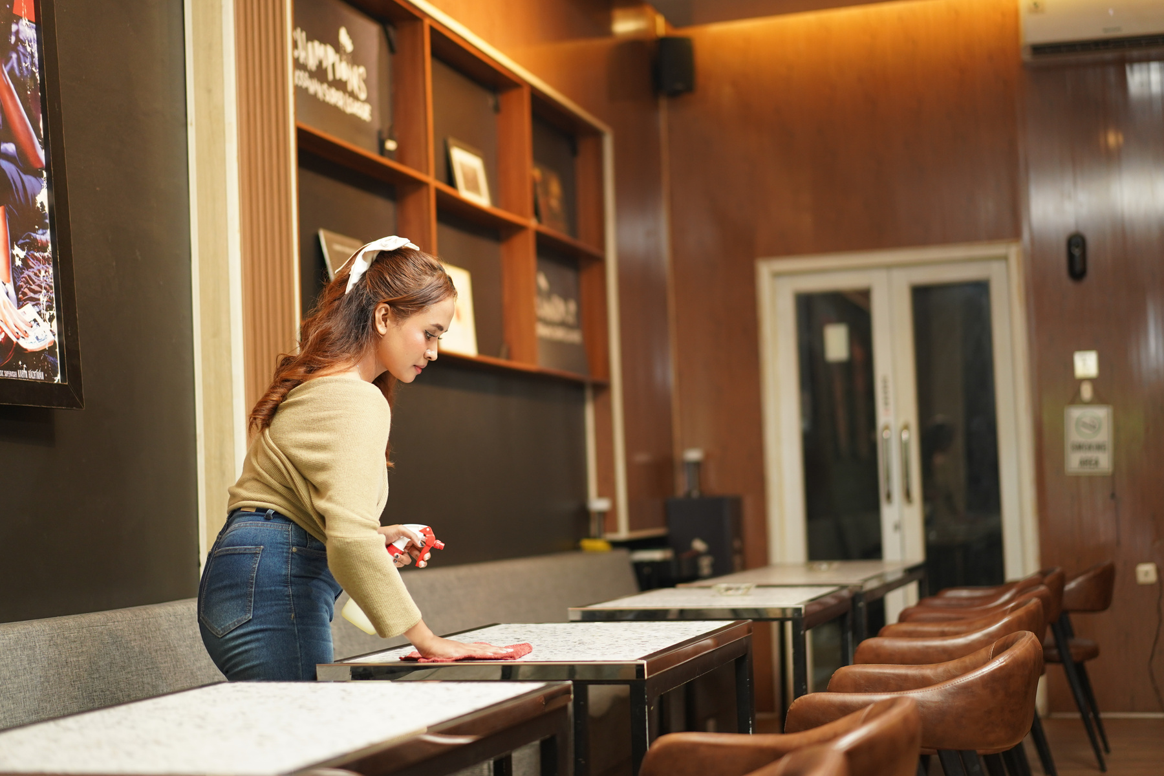
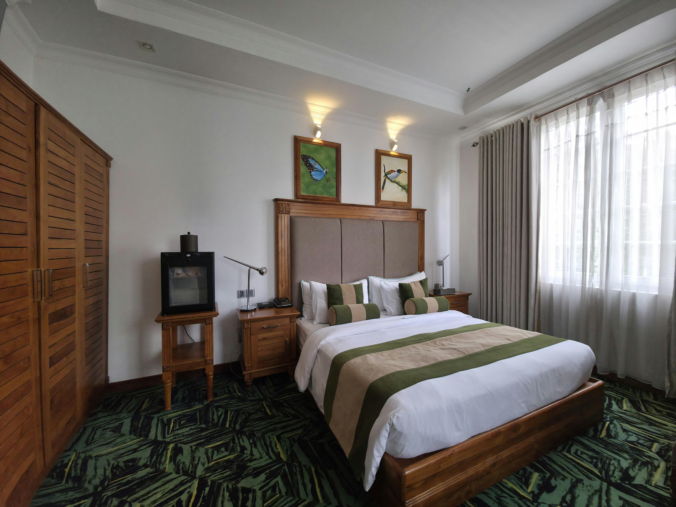
Modern Hospitality Challenges
Staff overwhelmed by manual processes and operational coordination
Disconnected systems impacting real-time visibility and service quality
Reactive service management increasing costs and guest dissatisfaction
AI usage confined to basic automation instead of intelligent, adaptive orchestration

Slide 4
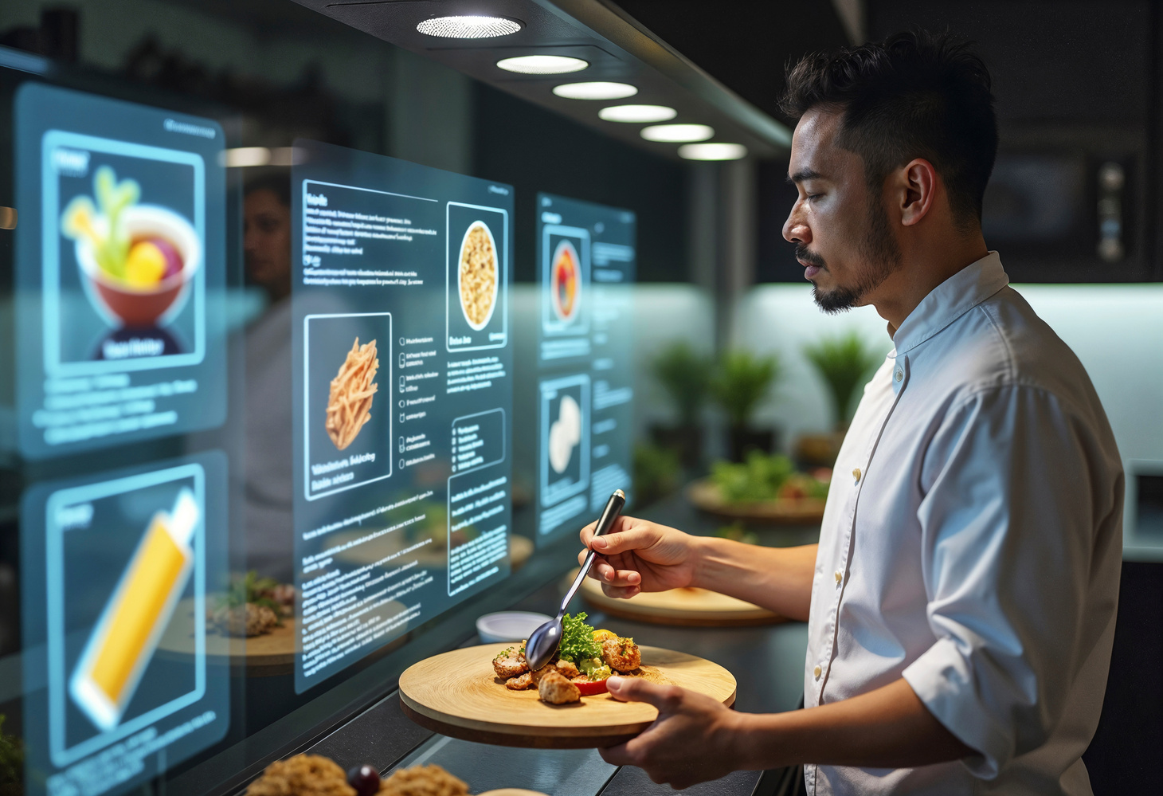
NEXT-GEN AGENTIC AI FOR HOSPITALITY

Slide 5

How Our Agentic AI Works
1
Integrate
Securely connect PMS, POS, CRM, booking, and guest systems.
Built to Elevate Guest Experiences and Operations
Train AI on your brand standards, workflows, and guest preferences.
2
Train
3
Create AI assistants and automated workflows for guests and staff.
Build
4
Deploy & Govern
Deploy with real-time monitoring, security, and governance controls.

Slide 6
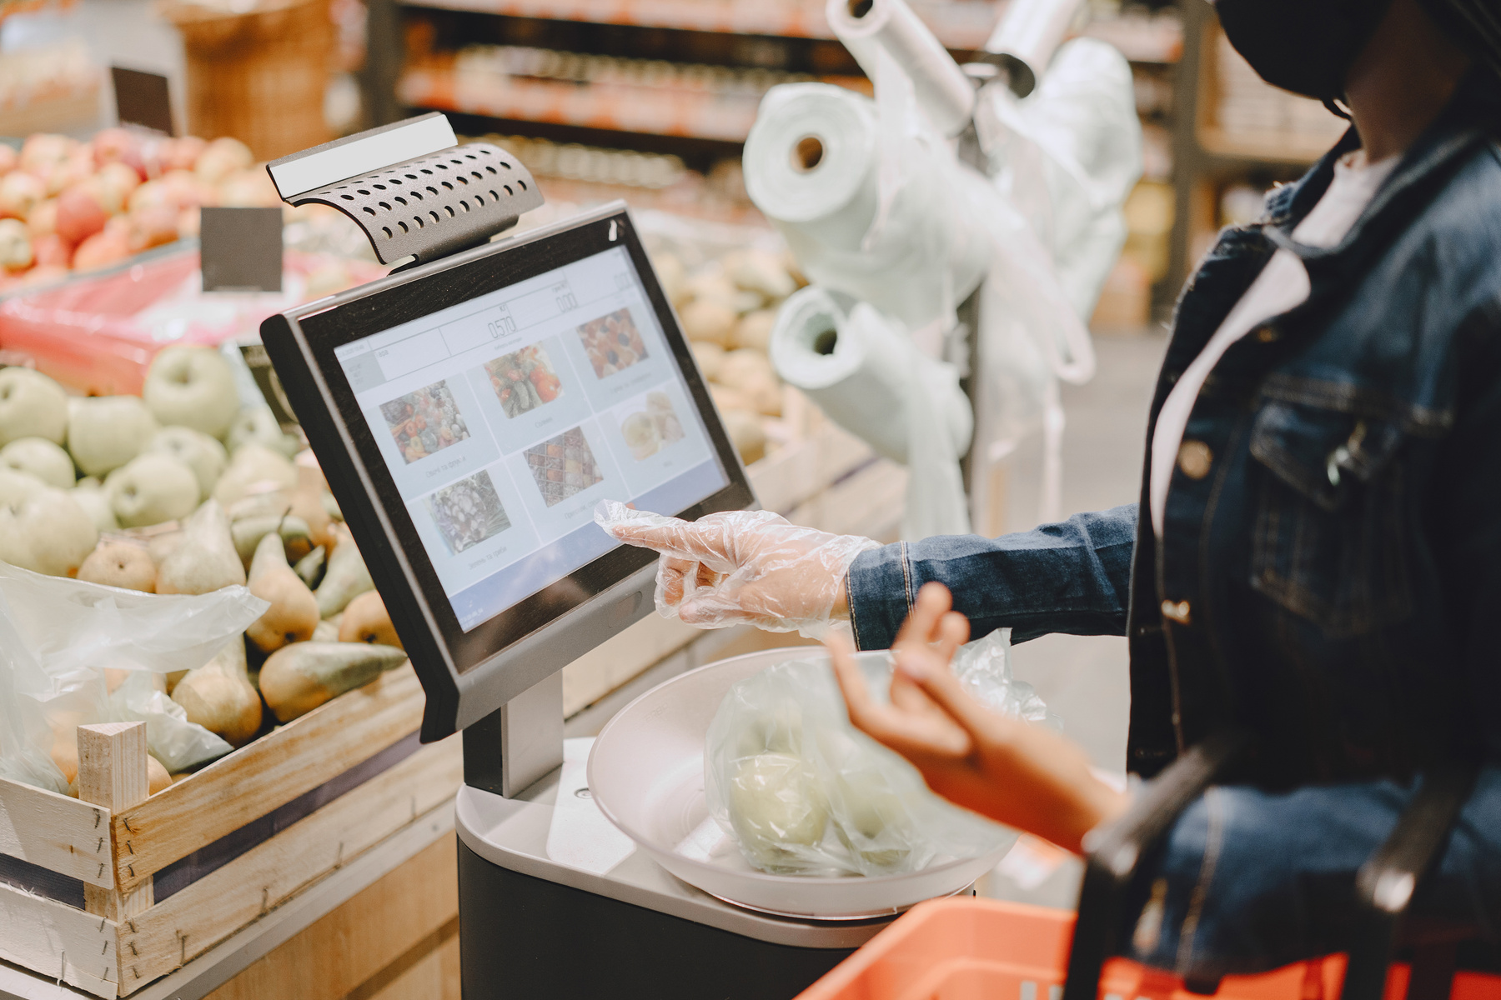
AI-Powered POS & Order Orchestration
Automates order processing, billing, and inventory in real time
Uses AI to optimize kitchen workflows and service coordination
Reduces order errors and service delays
Improves table turnover and performance during peak hours

Slide 7
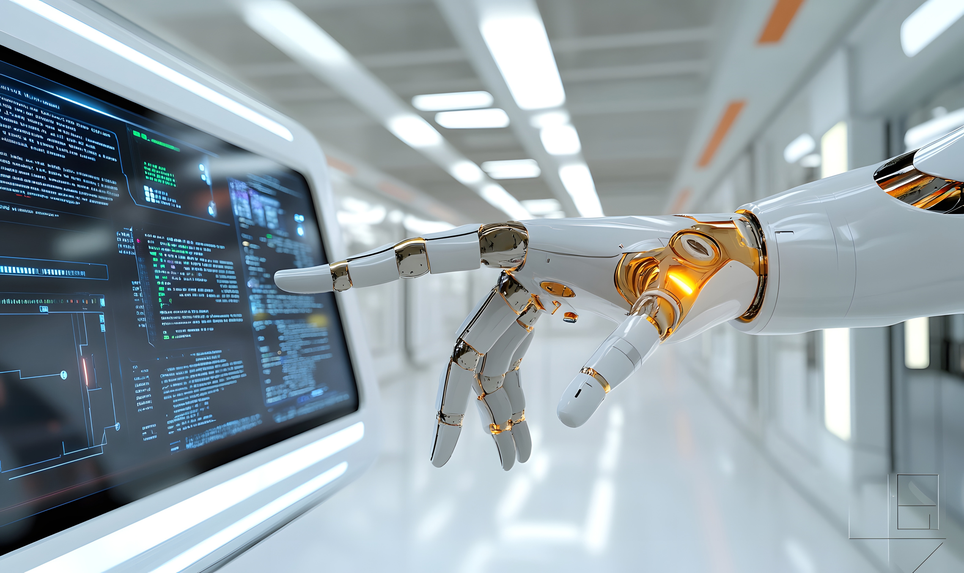
AI-Driven Loyalty & Guest Retention
Analyzes guest behavior and visit patterns using AI
Delivers personalized rewards and targeted offers in real time
Integrates seamlessly with CRM and guest engagement systems
Increases repeat visits and guest lifetime value

Slide 8
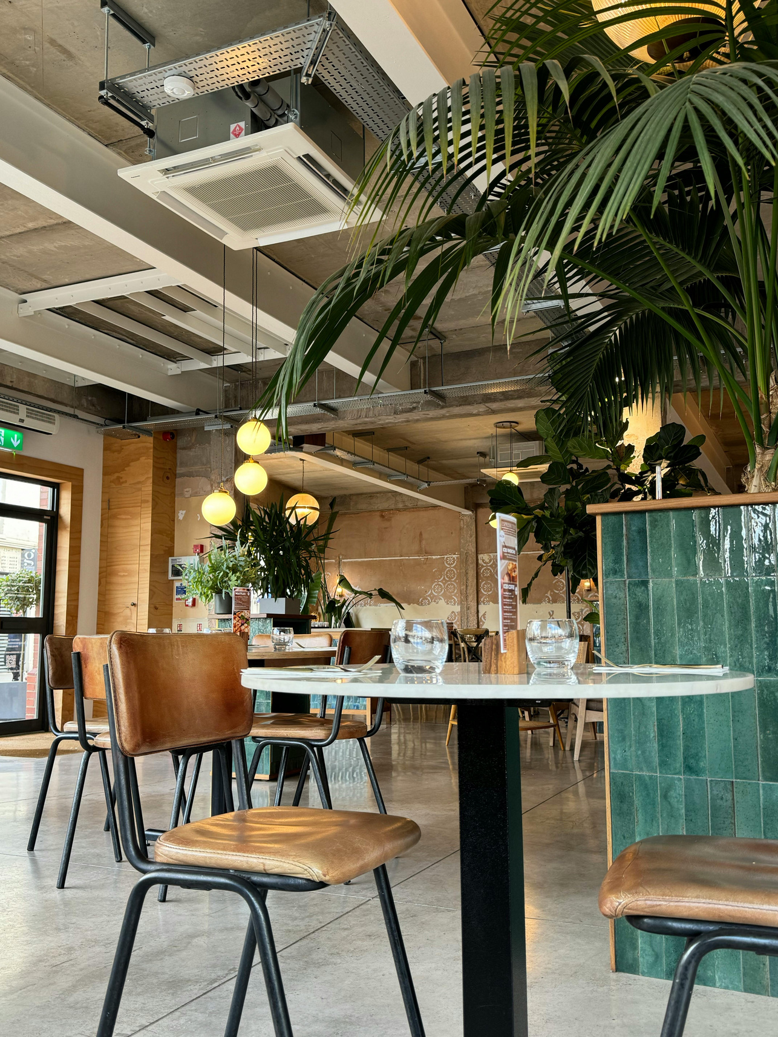
AI-Enabled Restaurant Operations Hub
Centralizes orders, staffing, and inventory across locations
Reduces food waste and operational inefficiencies
Ensures consistent service quality across venues

Slide 9
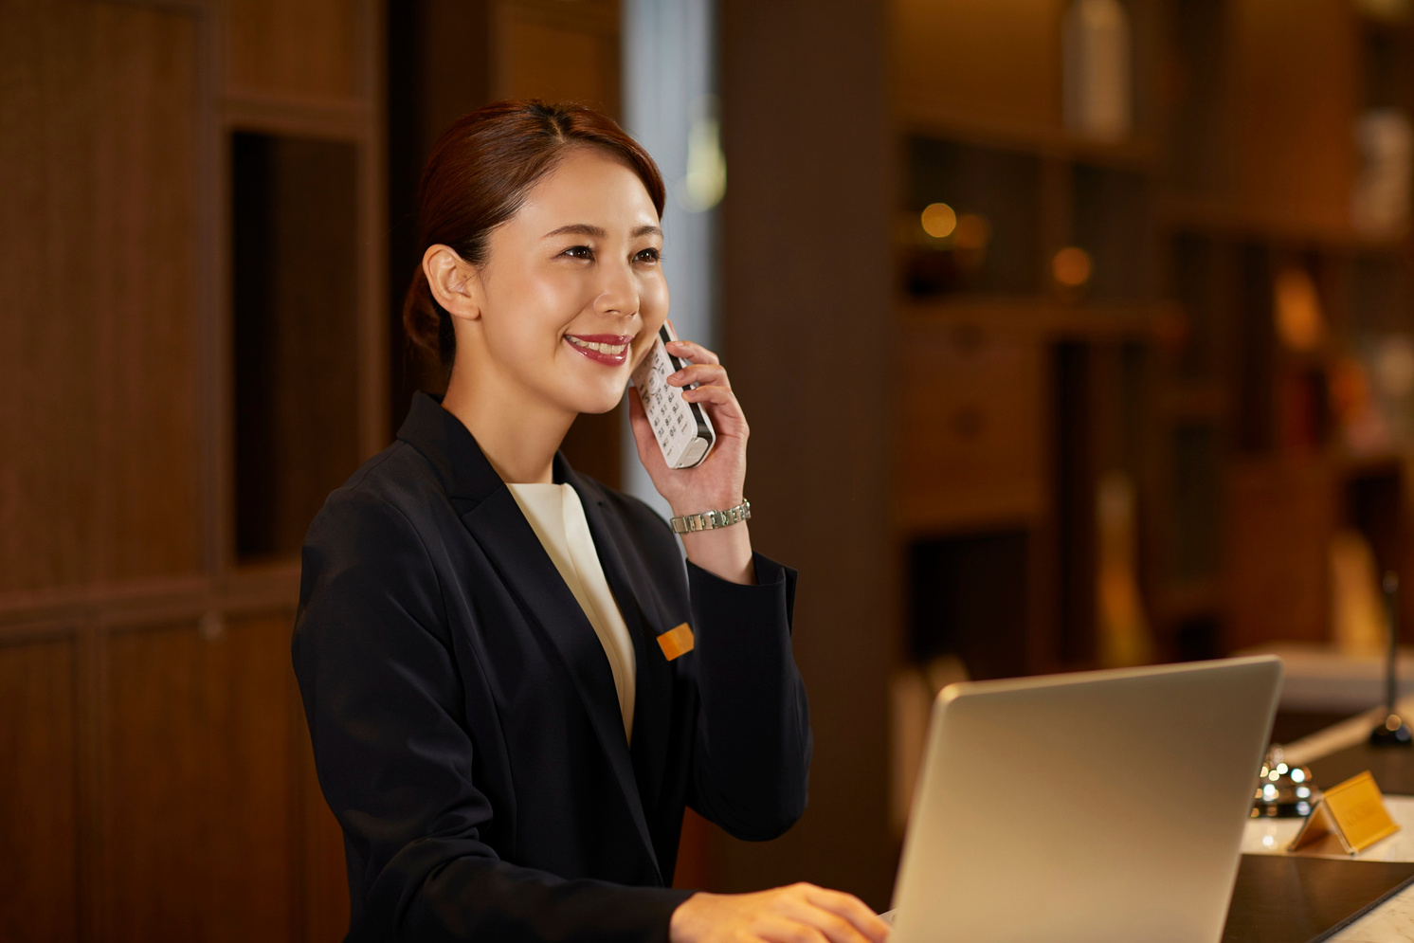
Intelligent Reservation & Availability Orchestration
Synchronizes real-time availability across all booking channels
Uses AI to predict and reduce no-shows automatically
Automates confirmations, payments, and scheduling workflows
Ensures seamless check-ins and guest coordination

Slide 10

Real-Time Guest Insights & Experience Optimization
Captures guest feedback across digital and on-site touchpoints
Uses AI analytics to detect issues early
Enables rapid service recovery and improvements
Enhances guest satisfaction and brand loyalty

Slide 11
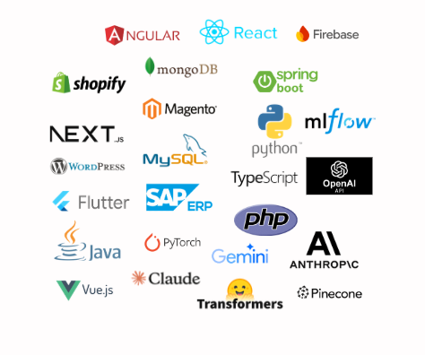
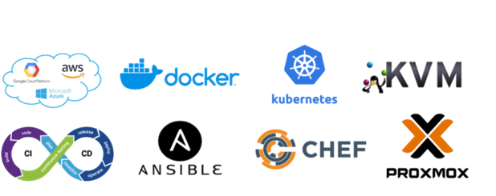


CLOUD TECHNOLOGIES
DEVELOPMENT TECHNOLOGIES

Slide 12


WHY PARTNER WITH US
Highly Experienced Professionals with Hands-On Expertise
Our expert team delivers proven AI solutions for hospitality operations and guest experiences—fast, reliable, and available 24/7 for seamless performance.
Scalable, Agile Delivery
Flexible team structures tailored to your business needs—ensuring craftsmanship, accountability, and rapid execution at any scale.
End-to-End IT & Cloud Solutions
From system analysis to enterprise cloud deployment, we drive digital transformation using the latest technologies and best practices.

Slide 13
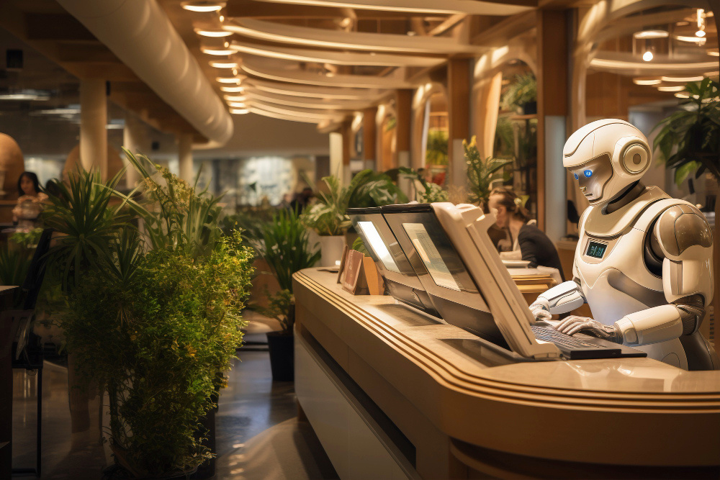
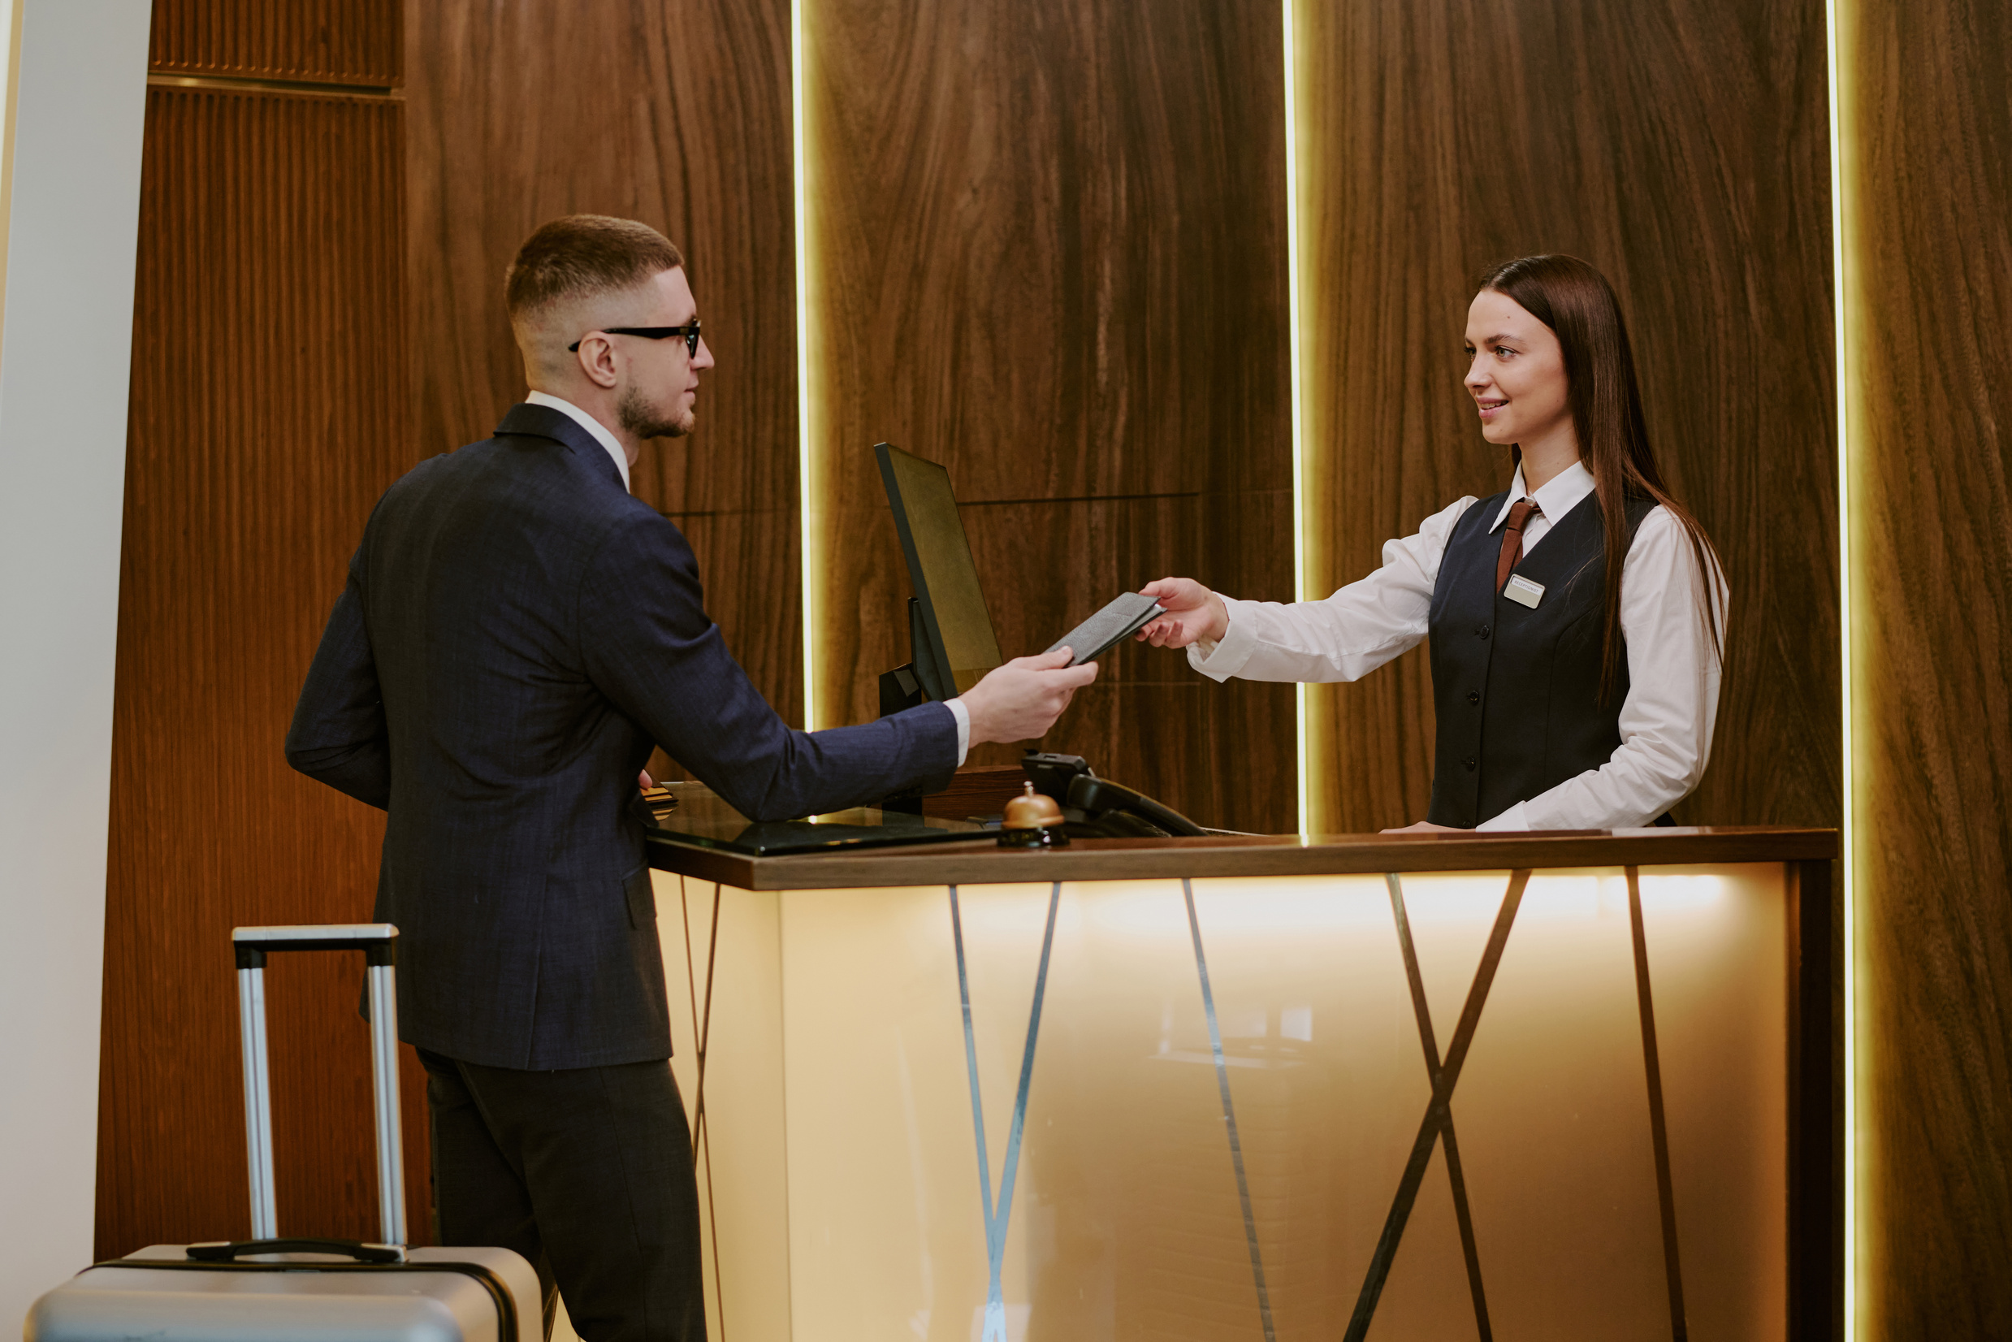
Let’s Build
THE FUTURE OF HOSPITALITY
Partner with today.
UNILAW Technologies

