Slide 1



TECHNOLOGIES
AI-Powered Healthcare & Enterprise Technology Solutions
Agentic AI | Clinical Intelligence | Secure Platforms

Slide 2




OUR VISION
Shift healthcare from reactive processes to proactive, intelligence-driven care
Embed agentic AI seamlessly within everyday clinical workflows
Reduce operational friction while improving patient outcomes and care quality

Slide 3

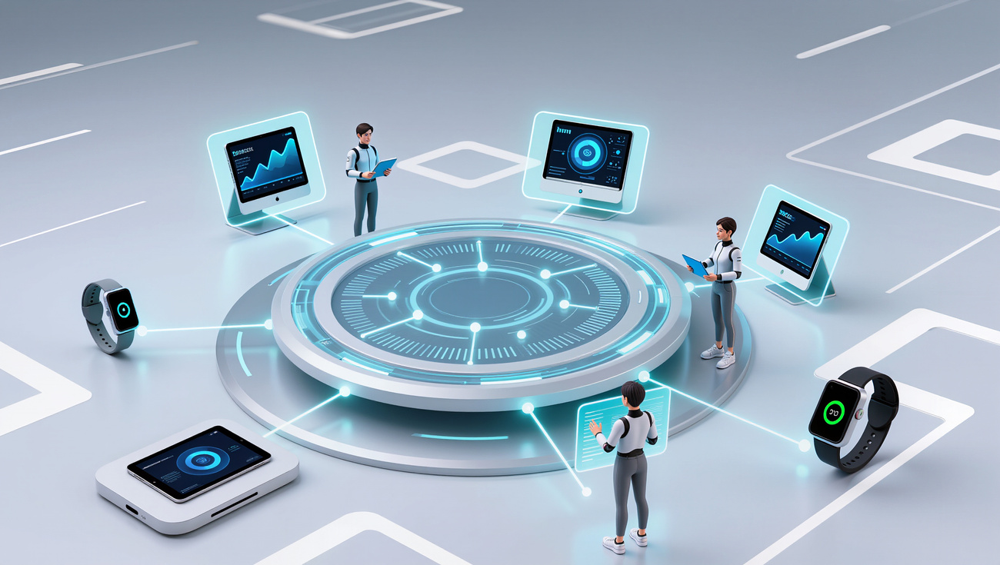
Modern Healthcare Challenges
Clinicians burdened by extensive administrative and documentation demands
Fragmented EMR/EHR systems hindering timely, informed decision-making
Predominantly reactive care models driving higher costs and clinical risk
AI adoption limited to basic automation rather than intelligent orchestration

Slide 4

AGENTIC AI HEALTHCARE ENGINES

Slide 5

How Our Agentic AI Works
1
Connect EMR/EHR, clinical APIs, patient data, and hospital systems securely.
Integrate
Modular, Secure, and Built for Healthcare Excellence
Teach agents your clinical protocols, guidelines, and patient context.
2
Train
3
Create care agents, assistants, and intelligent workflows for automation.
Build
4
Launch safely with observability, compliance, and full governance controls.
Deploy & Govern

Slide 6

Agentic AI Care Intelligence
AI agents analyze patient data and clinical context for confident, data-driven decisions.
Delivers clear summaries and practical clinical recommendations.
Suggests personalized treatments and predicts outcomes from clinical insights.
Scenario comparisons enable quick, optimal care path selection.

Slide 7
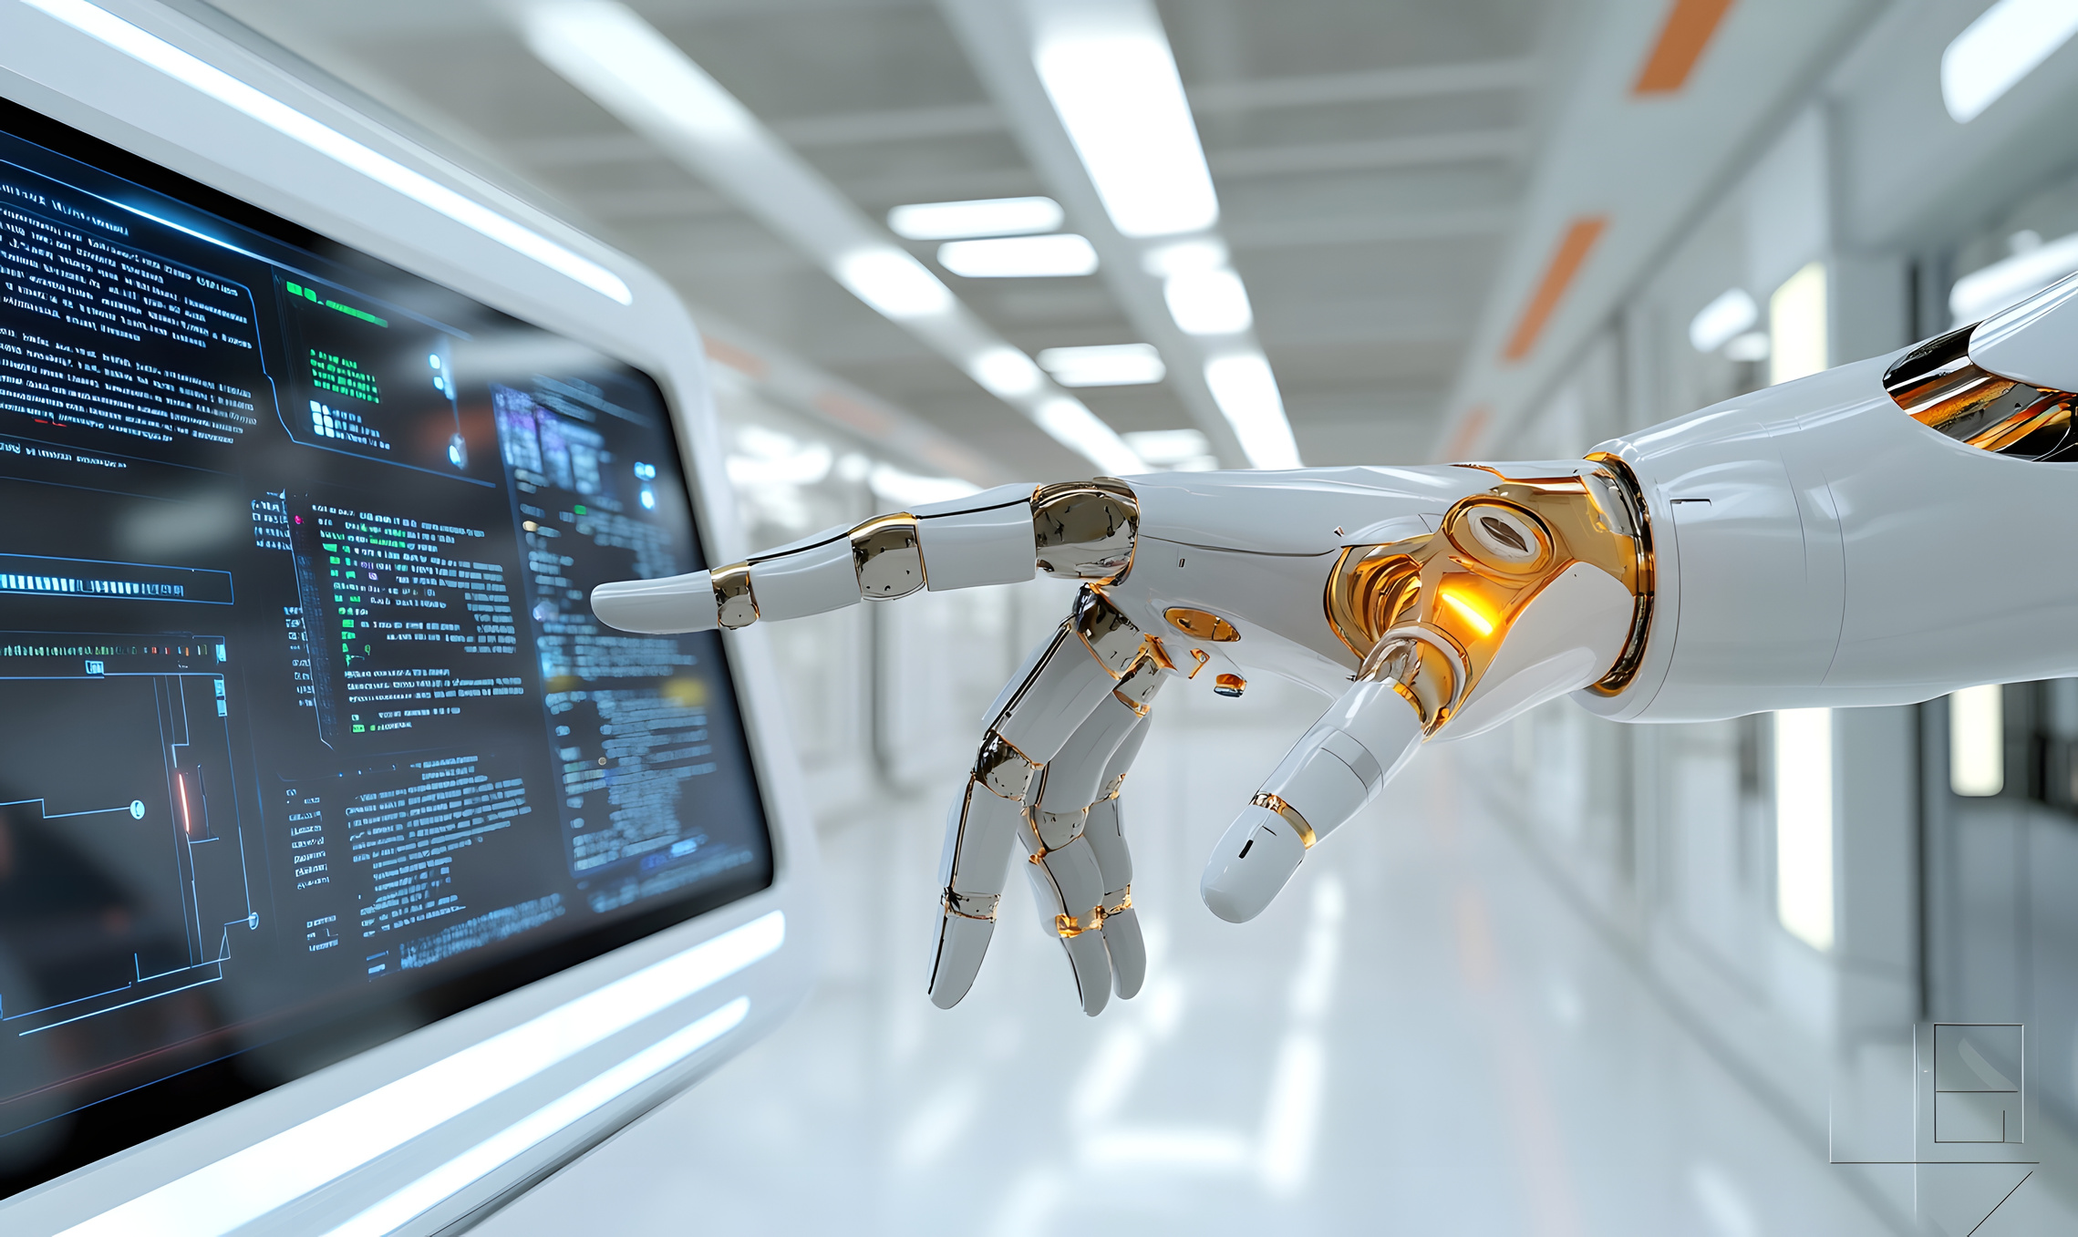
Intelligent Care Automation
Automates scheduling, reminders, and patient engagement
Proactively manages tasks to prevent delays and missed actions
Reduces manual effort and operational errors
Improves healthcare efficiency, allowing care teams to focus on better patient outcomes

Slide 8
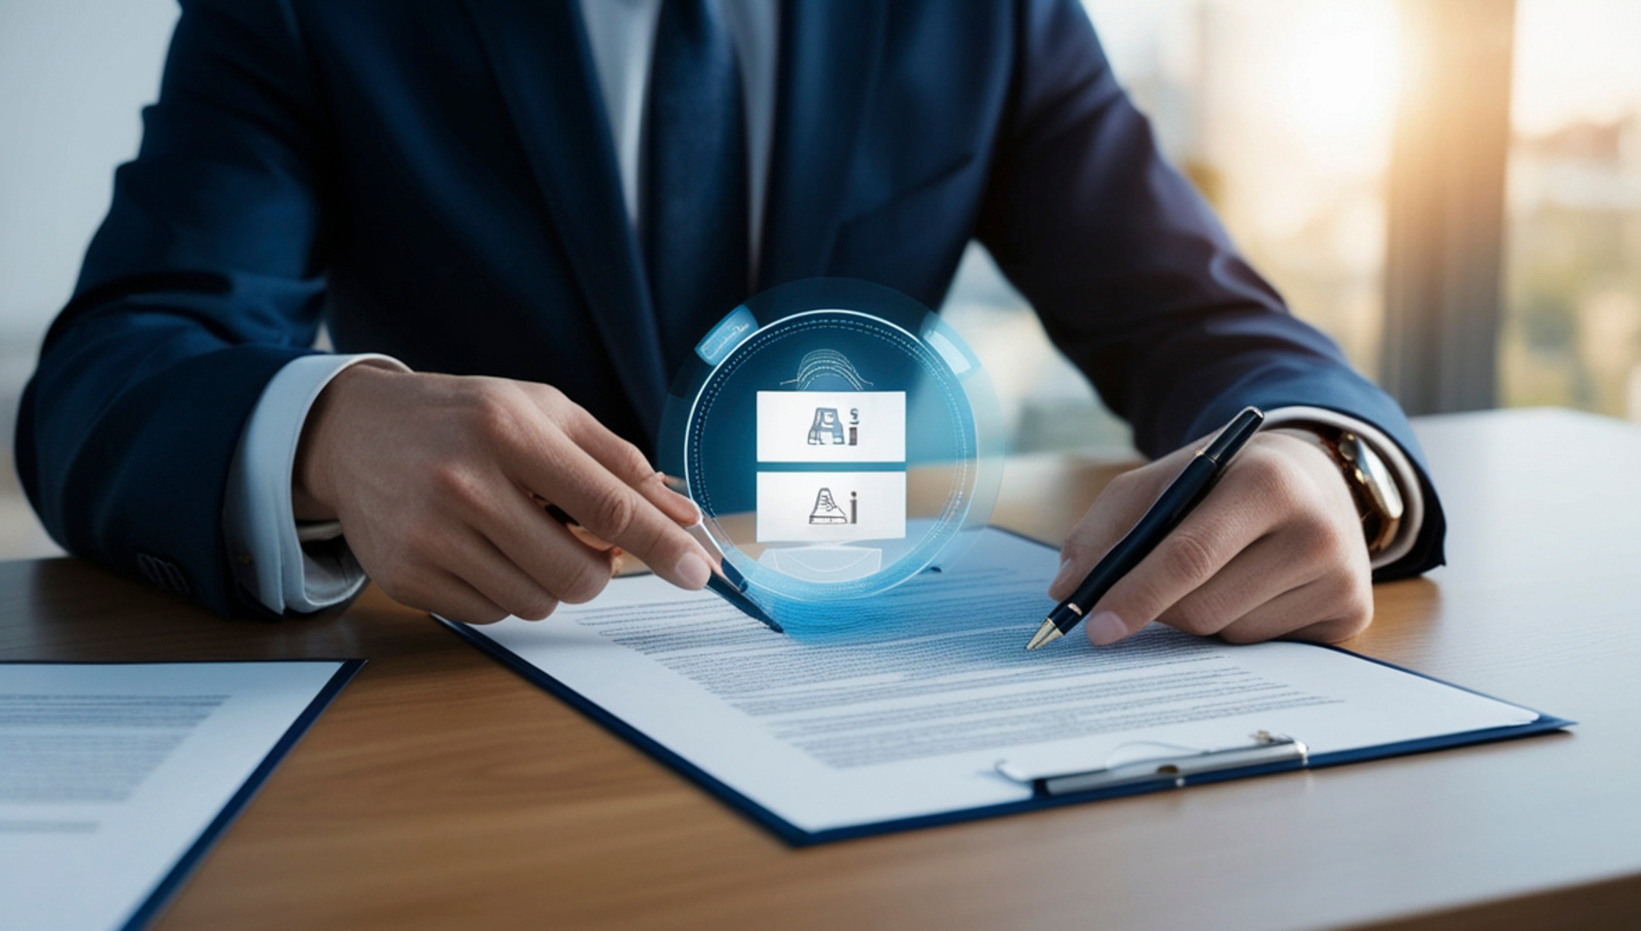
Intelligent Clinical Documentation
Captures and structures patient interactions automatically using AI
Summarizes clinical information for faster, accurate documentation
Generates clear, structured clinical reports from medical data
Integrates seamlessly with EMR/EHR systems for consistency and compliance

Slide 9

GenAI Platform Integration
Embeds AI assistants and dashboards into clinical applications
Integrates AI models through secure, scalable APIs
Orchestrates AI services for seamless workflows
Delivers real-time insights for informed decisions

Slide 10

Value & ROI
30–40% reduction in administrative workload
Higher clinician efficiency and job satisfaction
Faster decision-making with lower operational costs

Slide 11


Panel of Medical Technical Advisors
Dr. Rajesh Antony
Dr. Jishy George
MBBS, MD (Radiodiagnosis)
MBBS, MD (General Medicine)
HOD Radiodiagnosis & Interventional Radiology
Physician and Medical Director

Slide 12
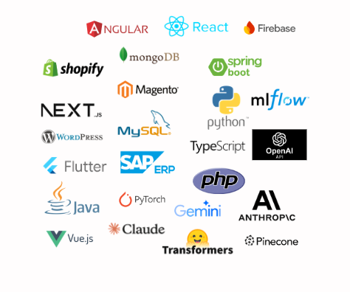
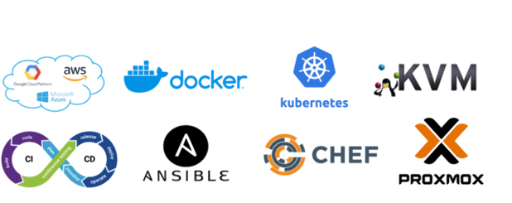


CLOUD TECHNOLOGIES
DEVELOPMENT TECHNOLOGIES

Slide 13


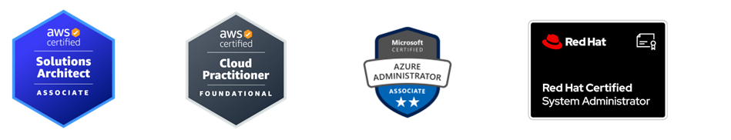
WHY PARTNER WITH US
Highly Experienced Professionals with Hands-On Expertise
Our highly skilled team, with proven hands-on expertise, works 24/7 to deliver accurate, fast, reliable AI solutions for complex clinical and business challenges.
Scalable, Agile Delivery
Flexible team structures tailored to your business needs—ensuring craftsmanship, accountability, and rapid execution at any scale.
End-to-End IT & Cloud Solutions
From system analysis to enterprise cloud deployment, we drive digital transformation using the latest technologies and best practices.

Slide 14


Let’s Build
THE FUTURE OF HEALTHCARE
Partner with today.
UNILAW Technologies

